Slide 1
Forest Federation Reading
Information Evening
Monday 4th February

Slide 2
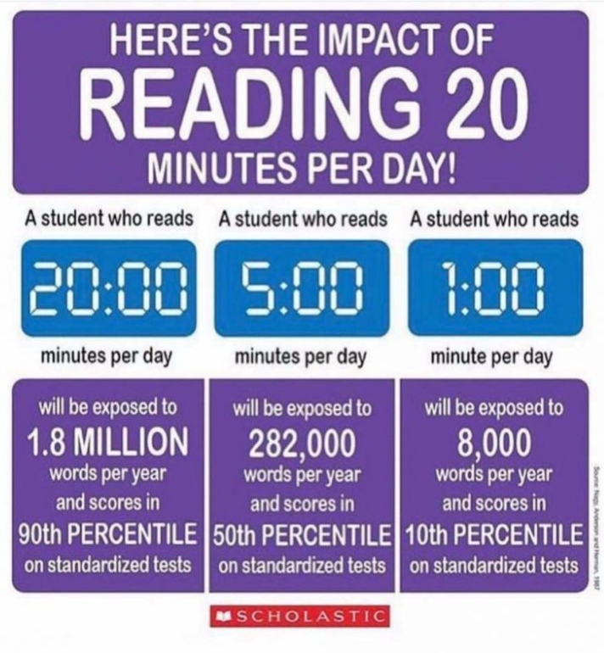

Slide 3
What we’re going to talk about this evening…
What reading looks like in school
  What you can expect to see in classrooms from across the Federation
What we would like to encourage with reading at home
National Curriculum Expectations
  Early Years
  KS1
  KS2

Slide 4
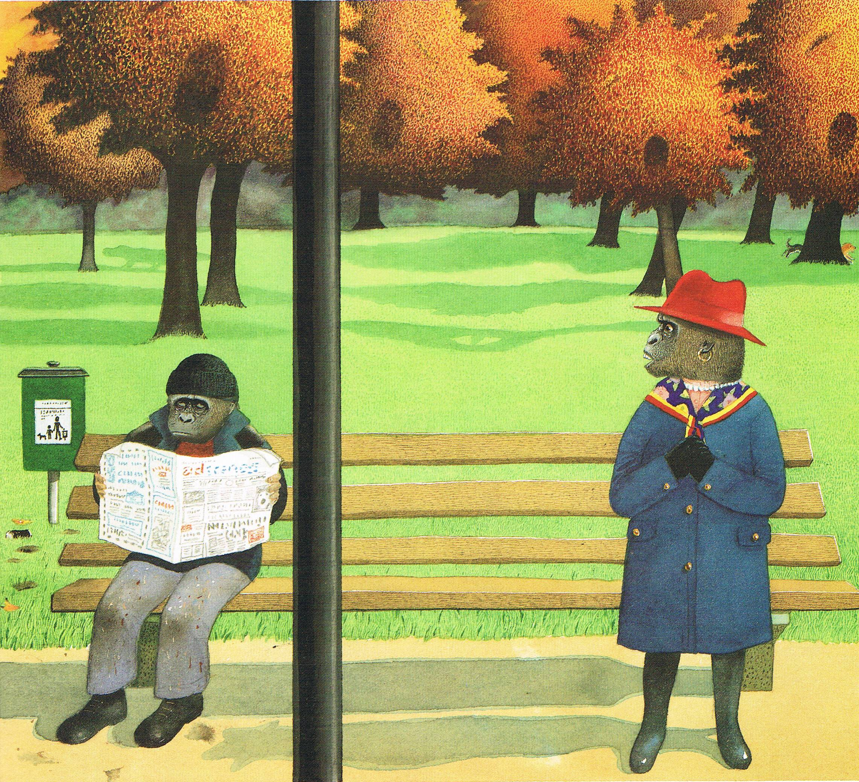
What can you infer from this picture?

Slide 5
https://www.youtube.com/watch?v=bw-PkwhbK_4&safe=true
Pie Corbett (Producer of the Talk4Writing scheme) talks about the importance of reading.

Slide 6
Reading at School

Slide 7
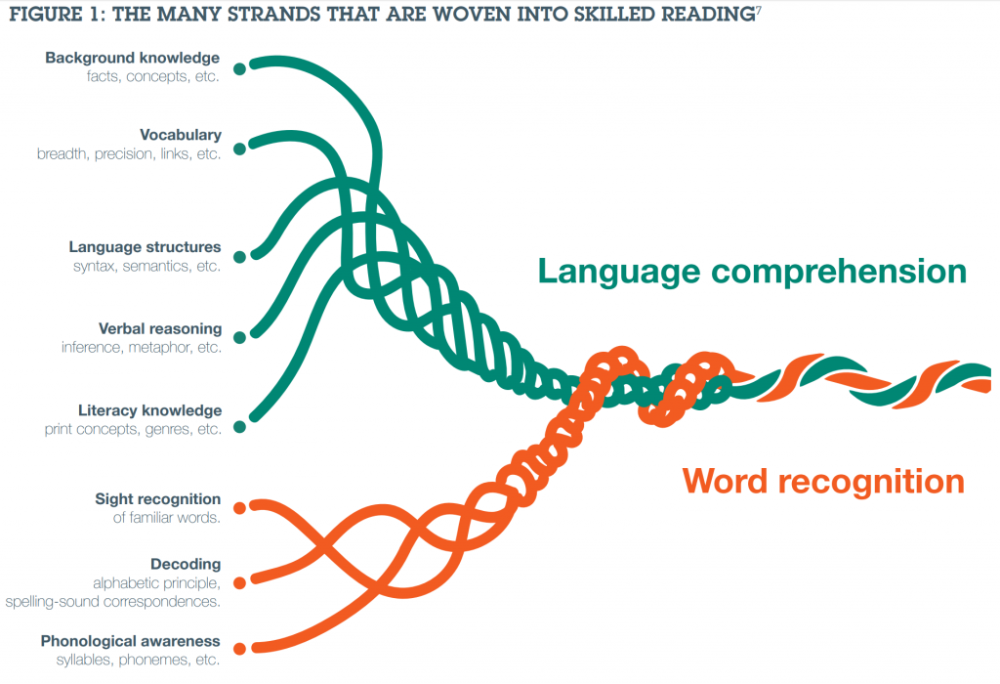
Scarborough’s Reading Rope (1)

Slide 8
What does reading look like in schools?
Every classroom will access reading at many times throughout the day
This is not always recorded but it happens!
It will look different in every classroom
Environments will help encourage and celebrate reading
Children read signs, labels, instructions, etc. all of the time
High quality texts are used to promote vocabulary and spark imagination
Different forms of reading lessons
Taught vocabulary lessons

Slide 9
Reading Lessons
One to one reading – the child works with an adult to read independently
  The child reads the text out loud to the adult
  Focuses on the mechanics of reading as well comprehension skills
Shared Reading – whole class looking at the same book or piece of text.
  The teacher selects a text and reads it to the class
  Book Talk to discuss comprehension of the text as well as pick out specific vocabulary and text features
Guided Reading – small groups looking at the same book or text
  Either read by the teacher or in sections by the children
  Focus on oral comprehension skills, introduces new vocabulary and text types

Slide 10
Daily Reading
Each class has a class book that is read to them daily
  This is pitched above the level of the children’s reading level to provide access to higher level vocabulary and text types
  The main aim of this time is ENJOYMENT!
  It also provides children with time to share books together and develop a shared love of reading
  Vocabulary – word pirates, squirrelling words, magpie words etc.
Poetry is an integrated part of the children’s reading in school
  Poems are shared, innovated and performed in class.

Slide 11
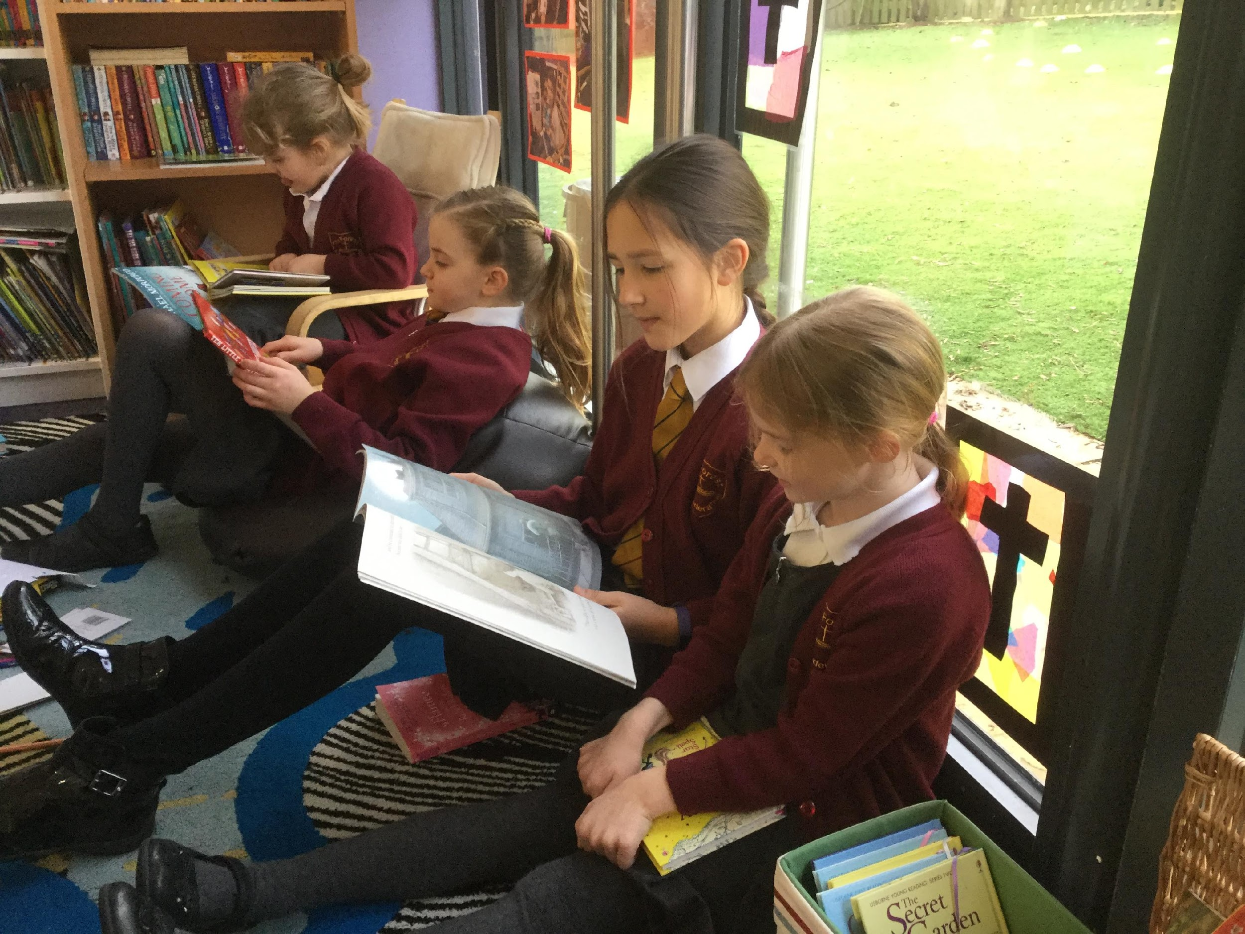
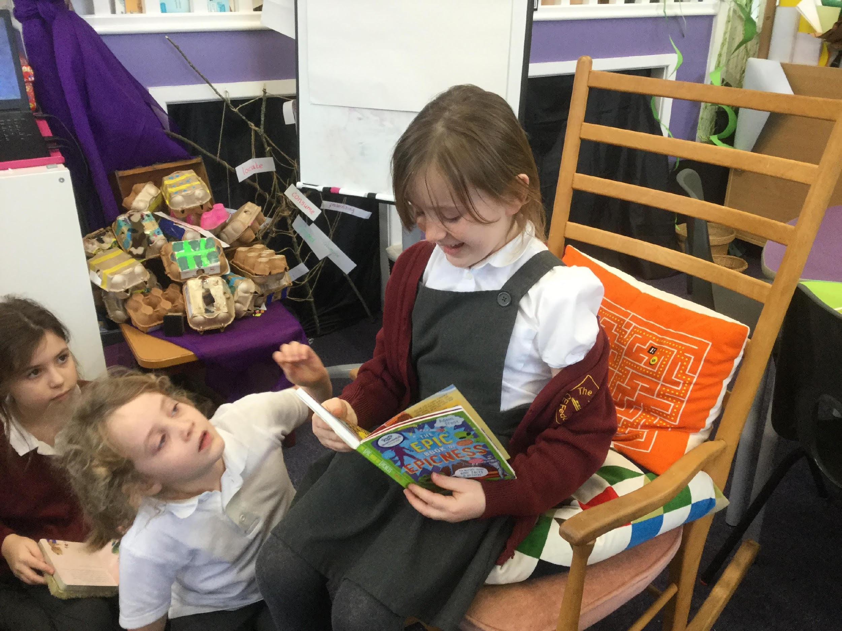
Whole Class
Book recommendations
  A time to share favourite books with the class
  Stars on spines
  Posters with favourite books
Reading Partners
  The children are paired up with someone in a different
  class and they share books together

Slide 12
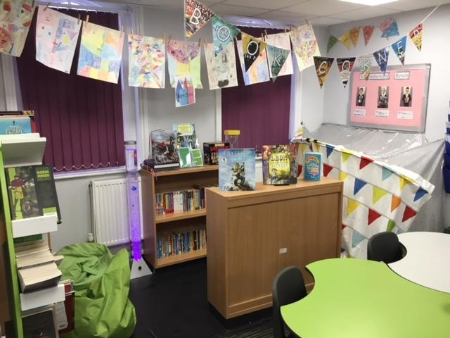
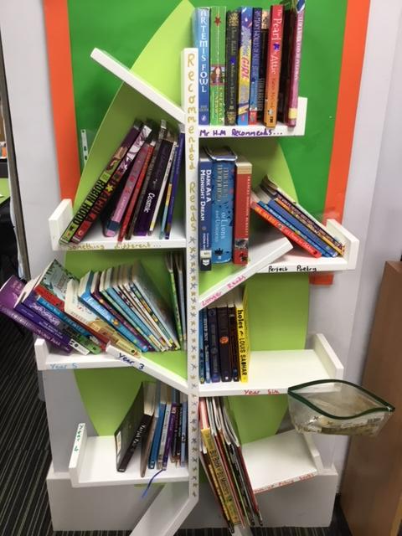
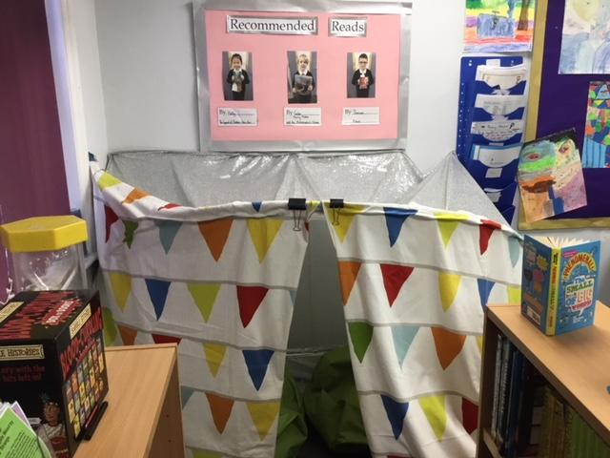
Some classroom reading areas…

Slide 13
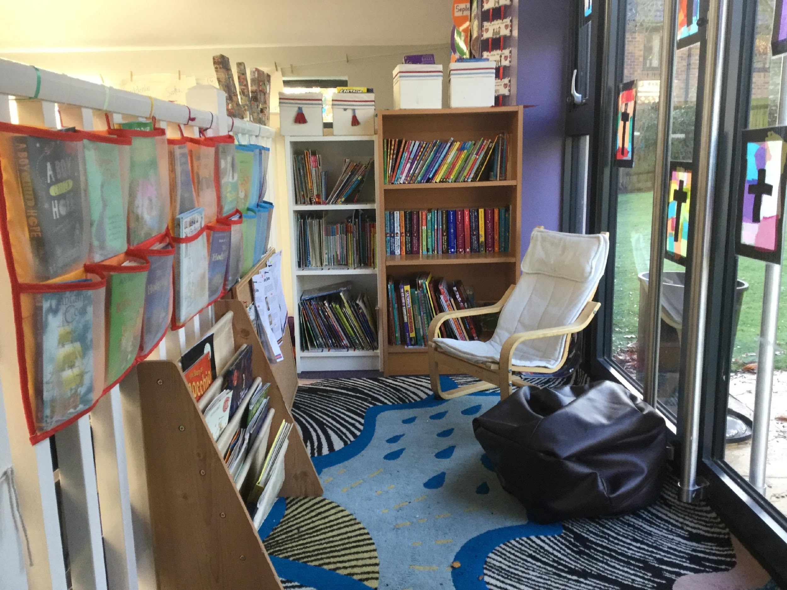
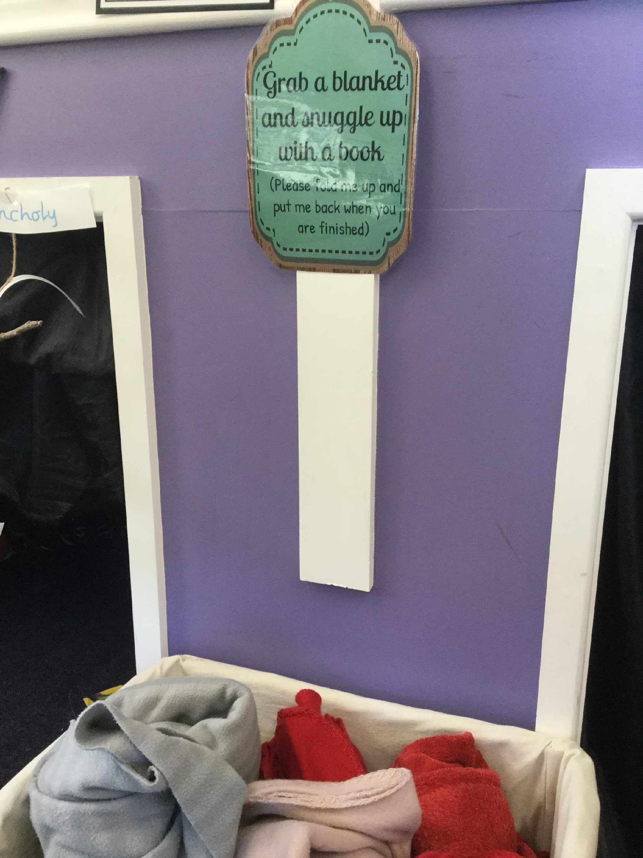
Some classroom reading areas…
Add photos

Slide 14
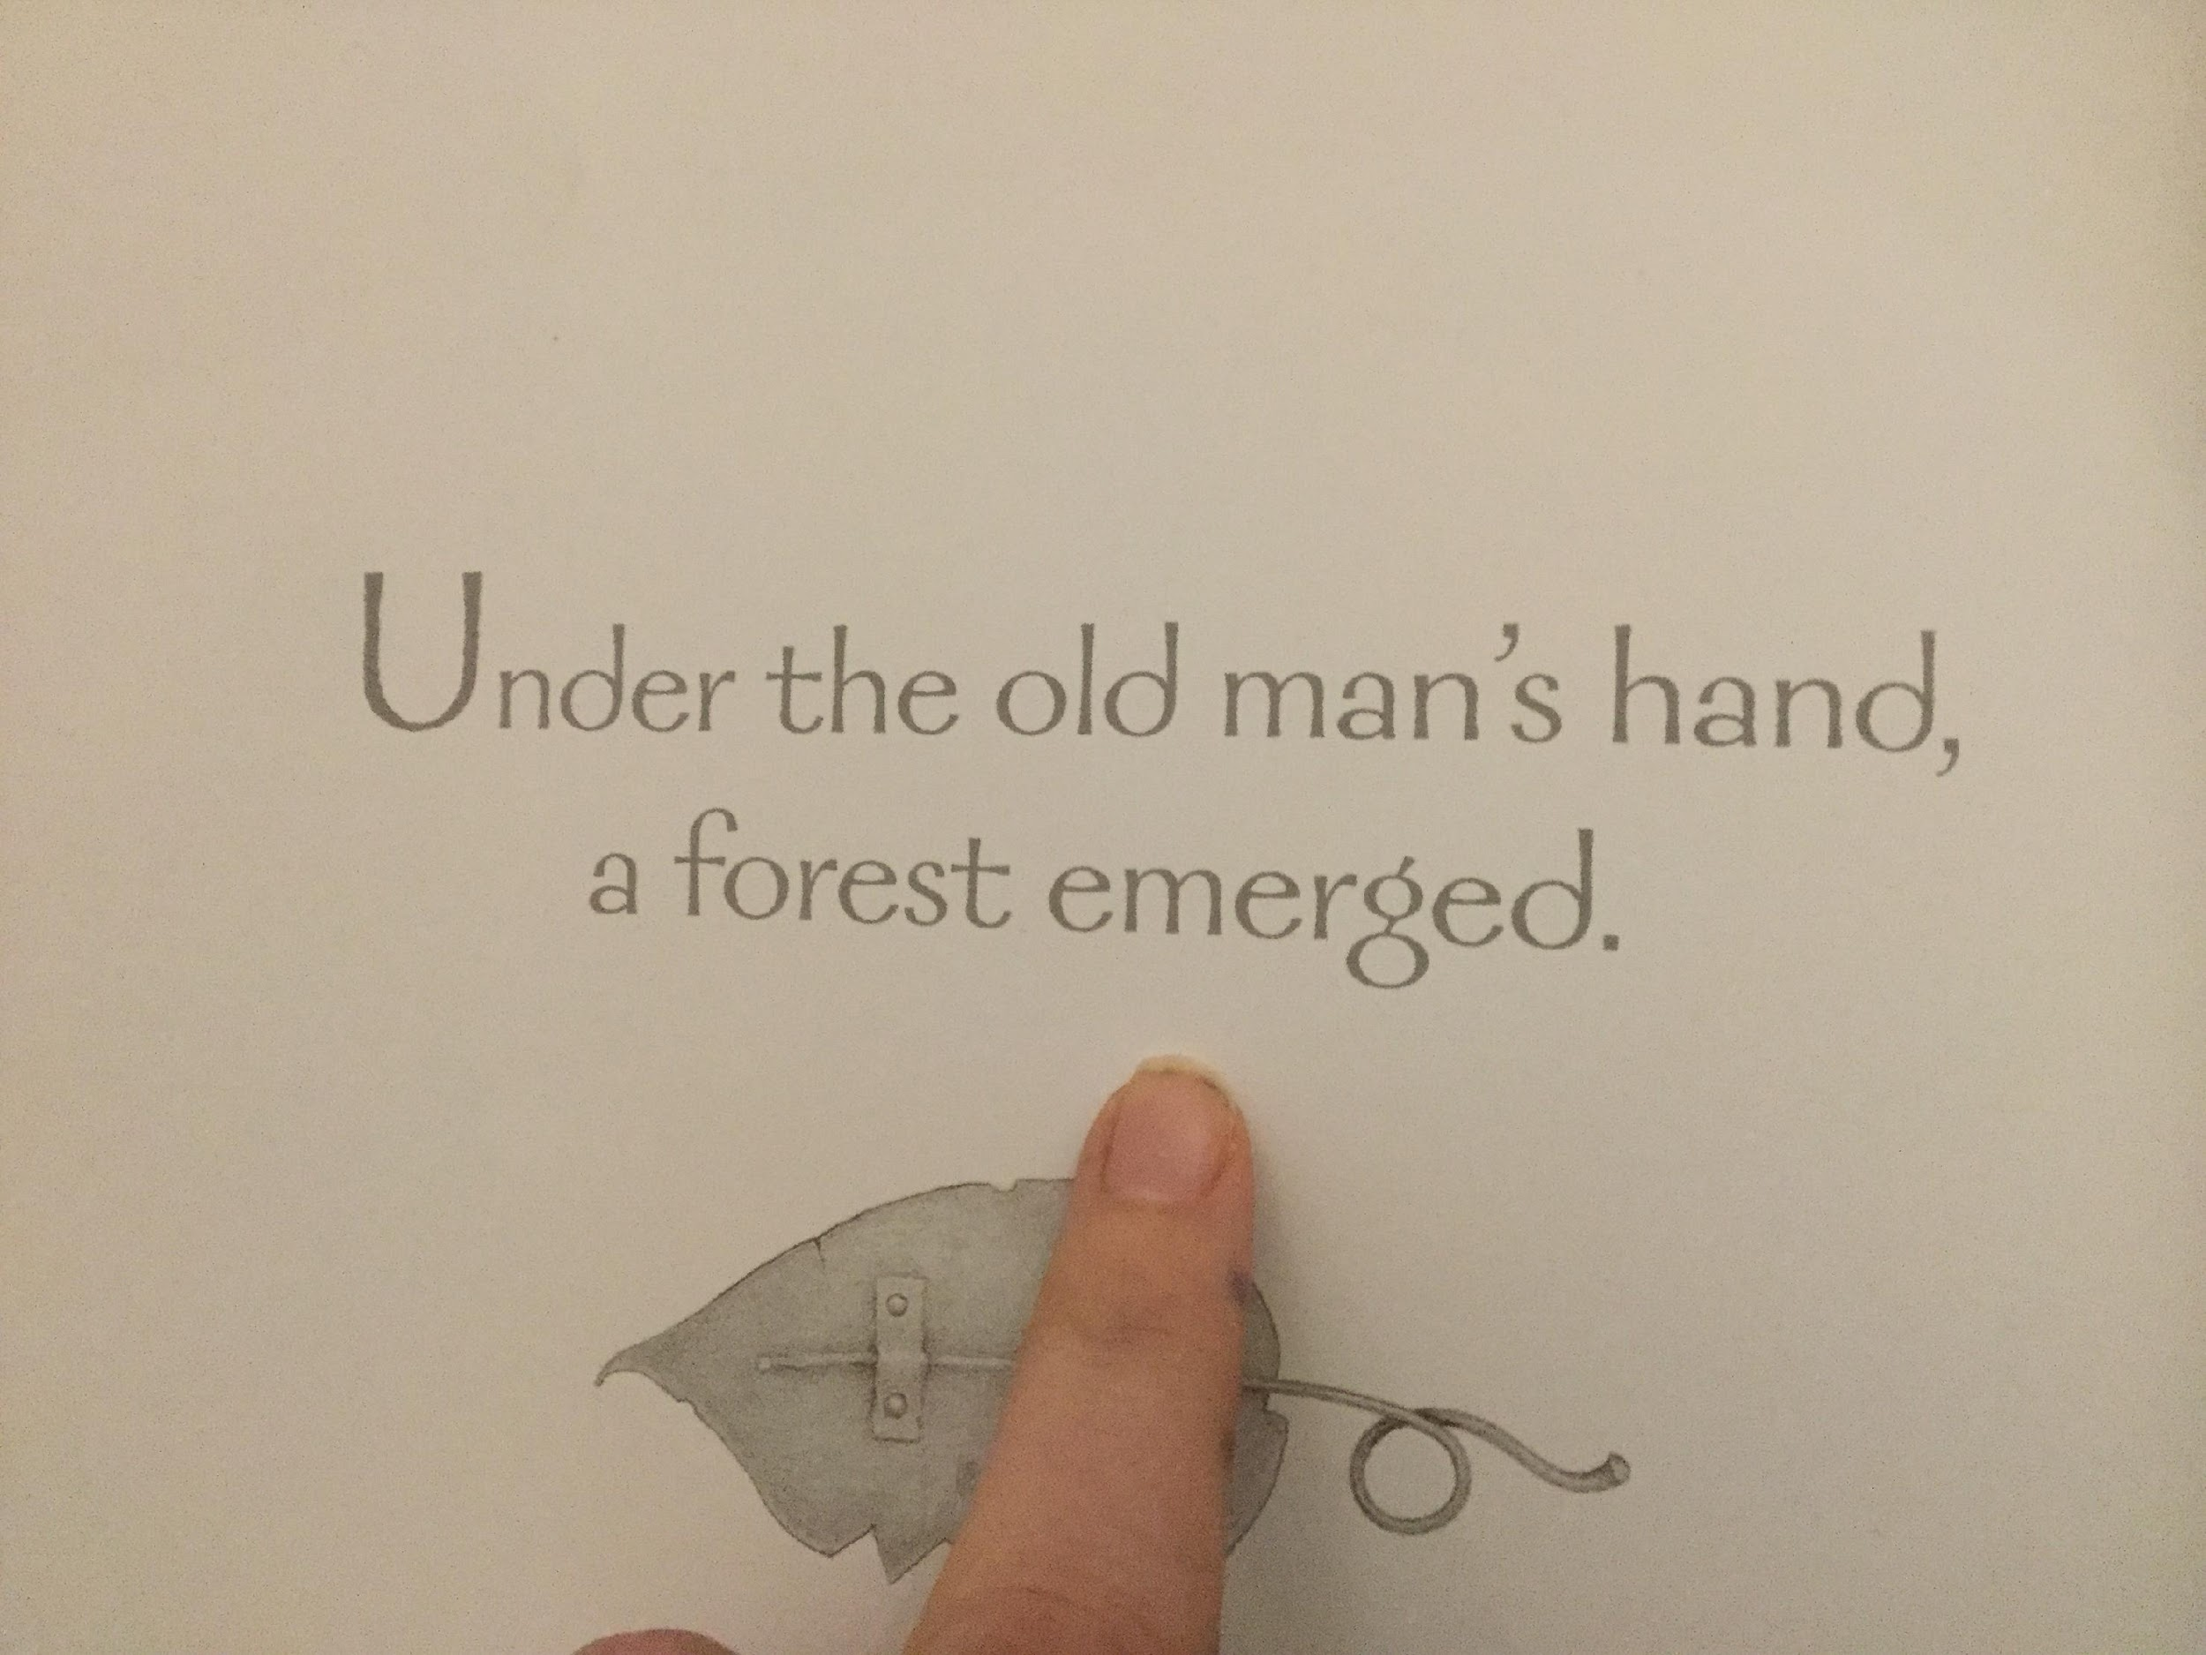
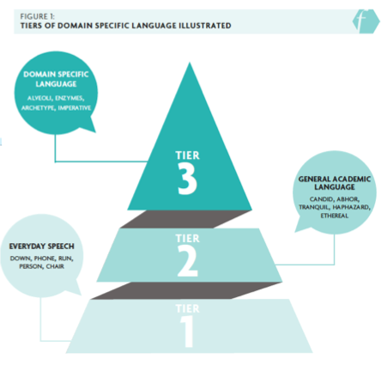
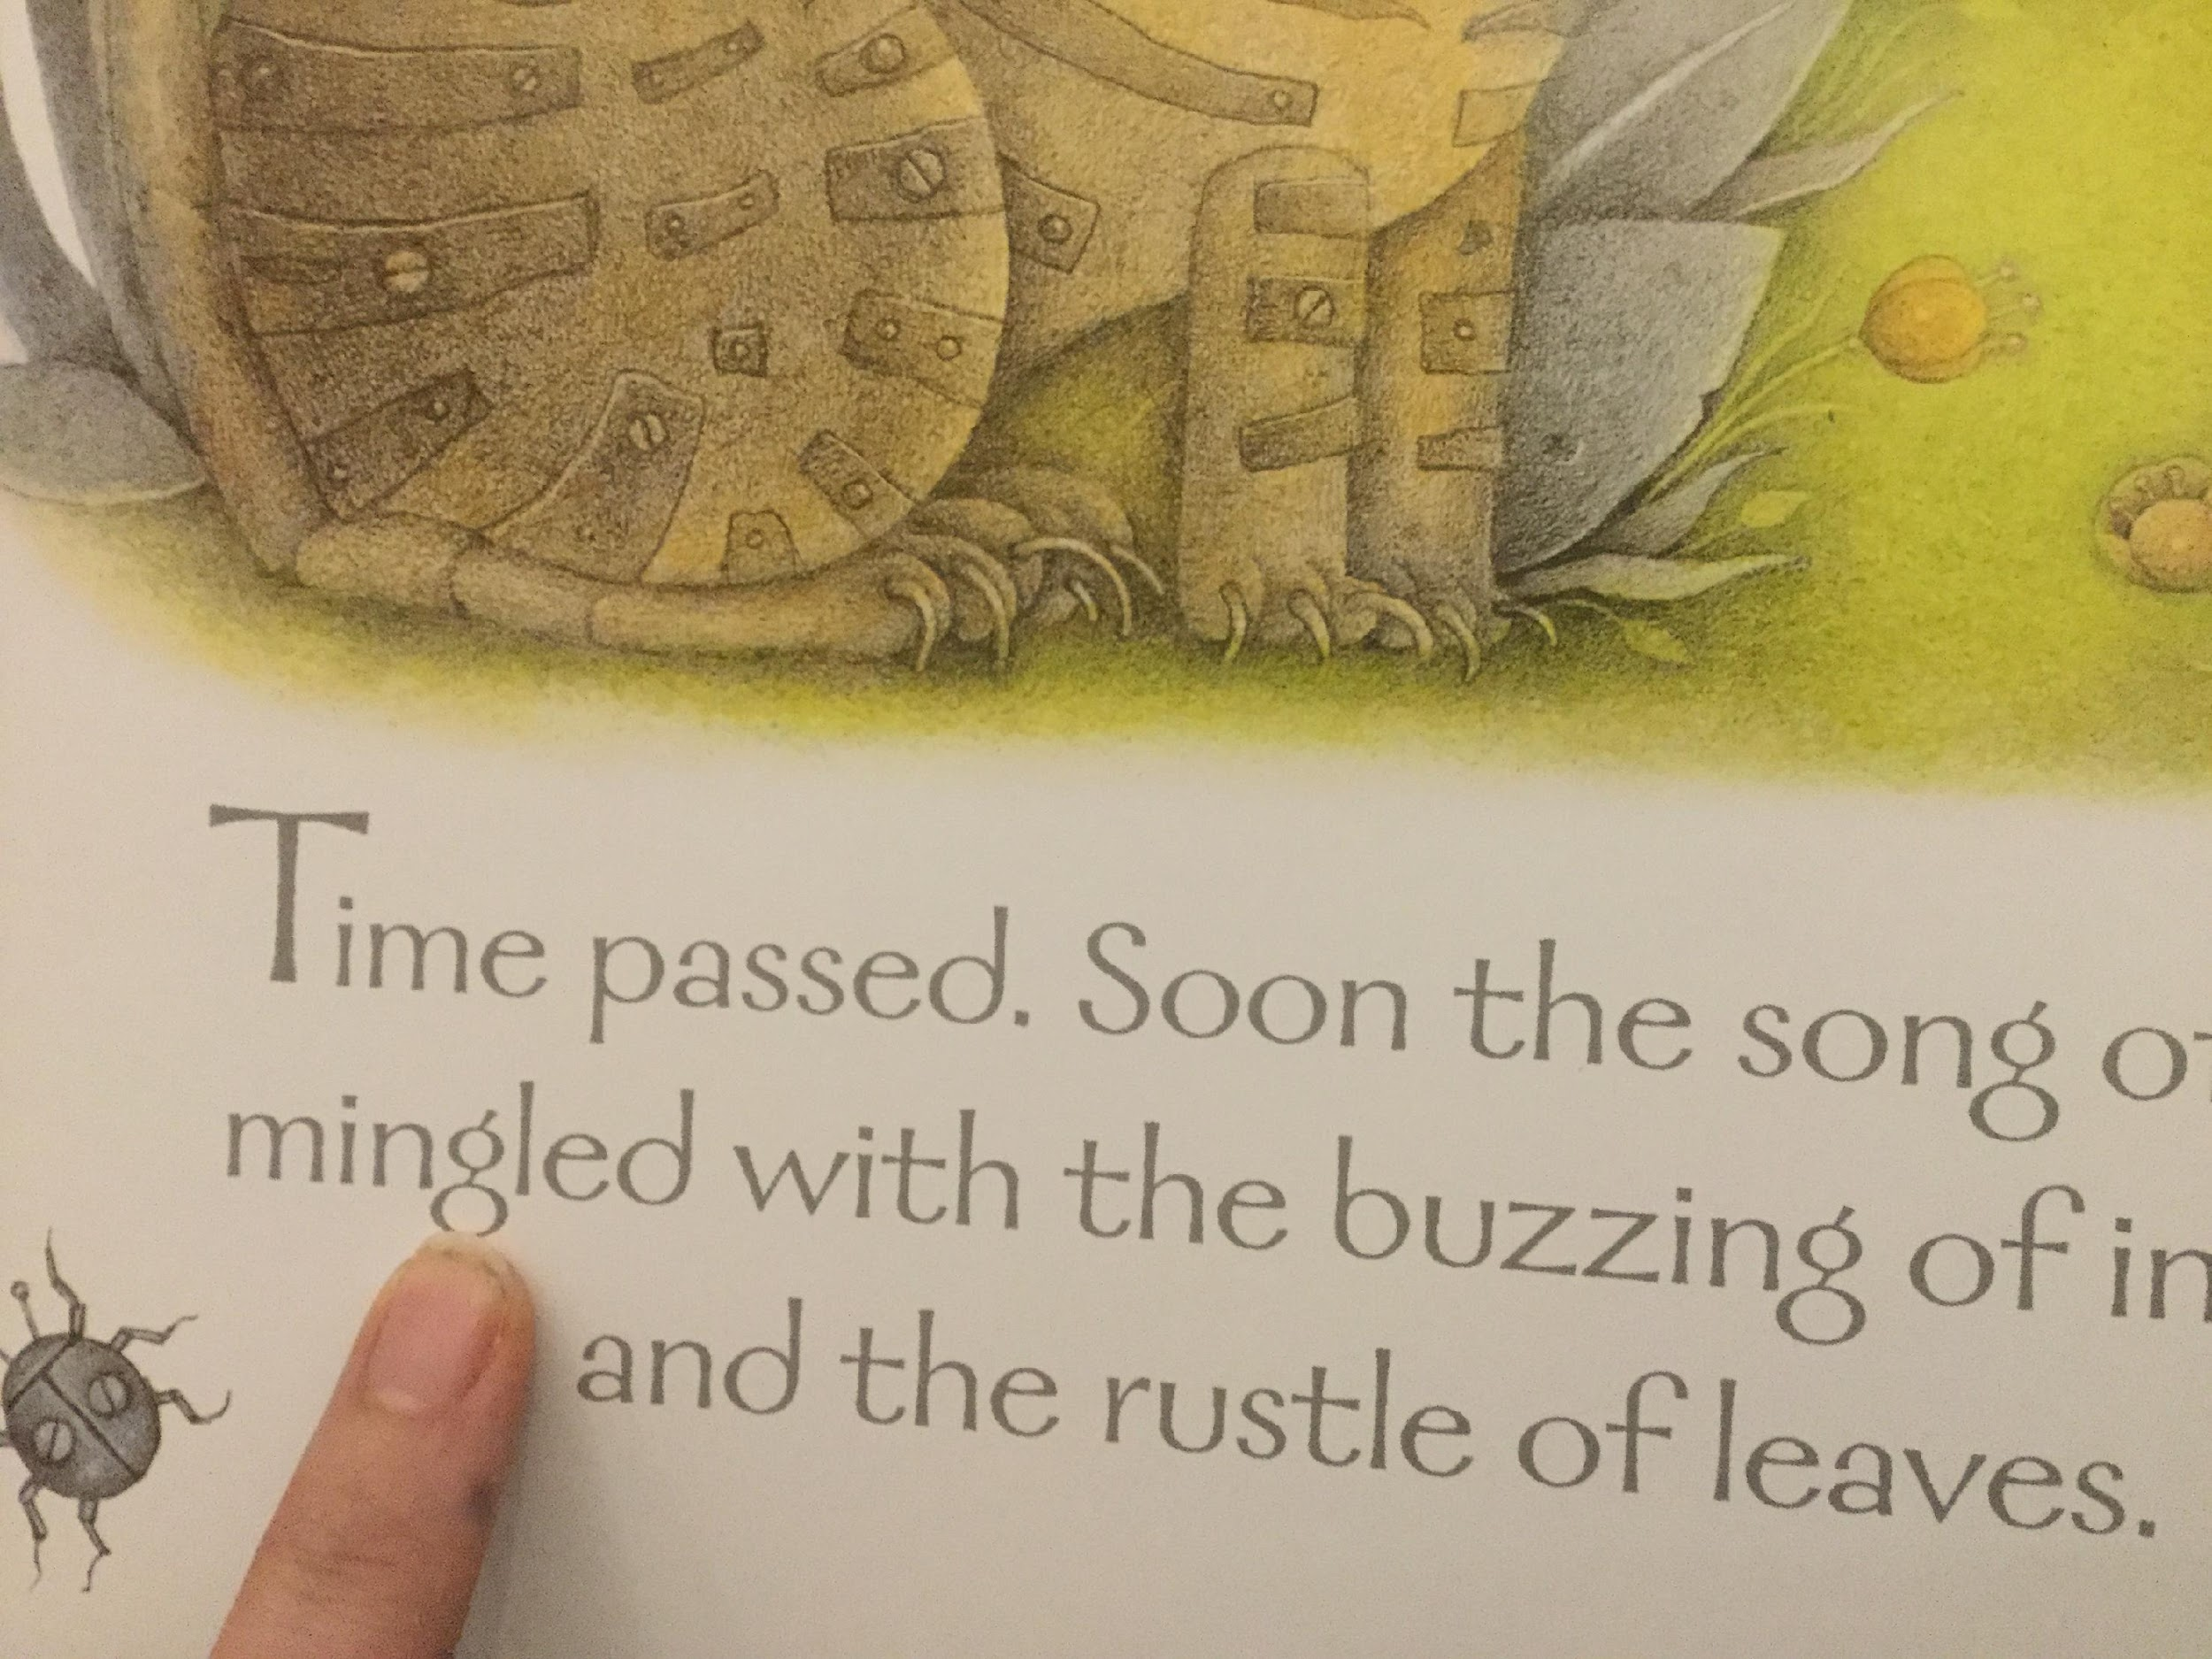
Teaching of vocabulary…

Slide 15
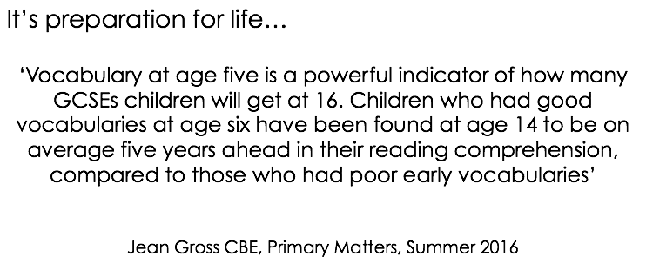
Teaching of vocabulary…

Slide 16
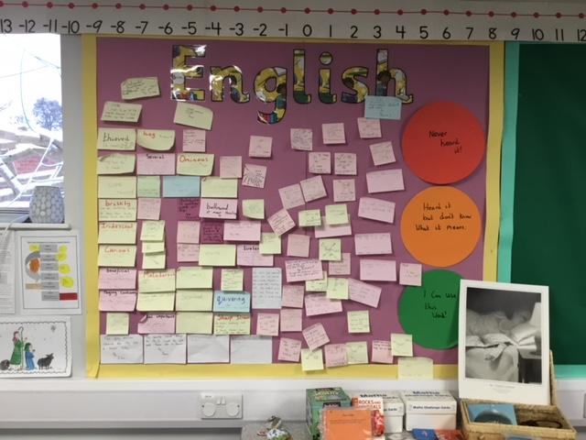
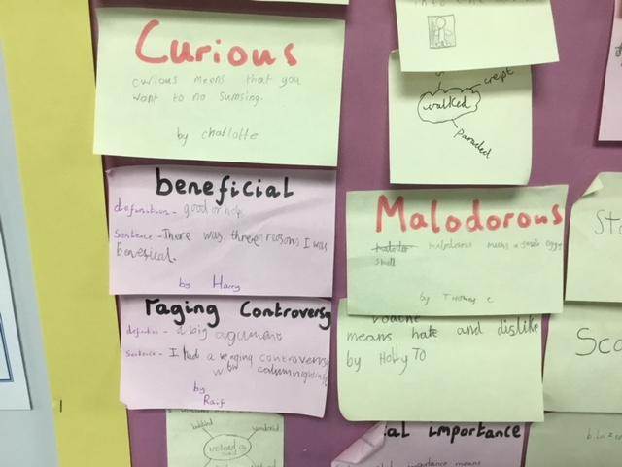
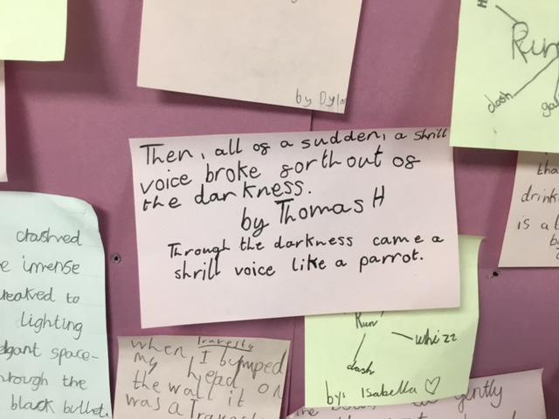
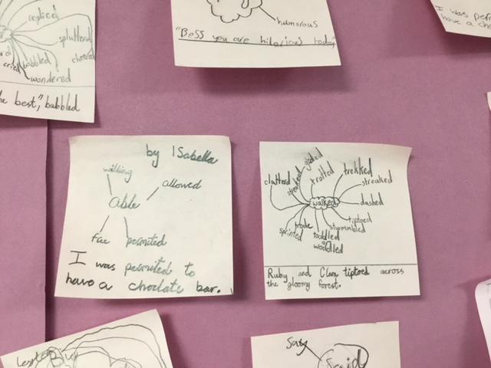
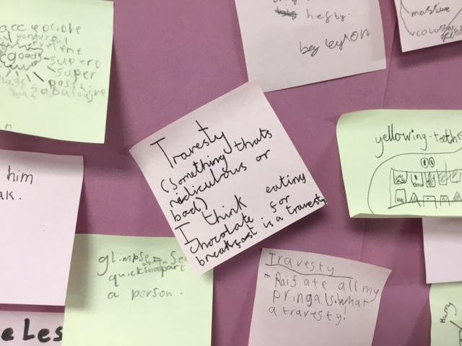
Vocabulary in classrooms…

Slide 17
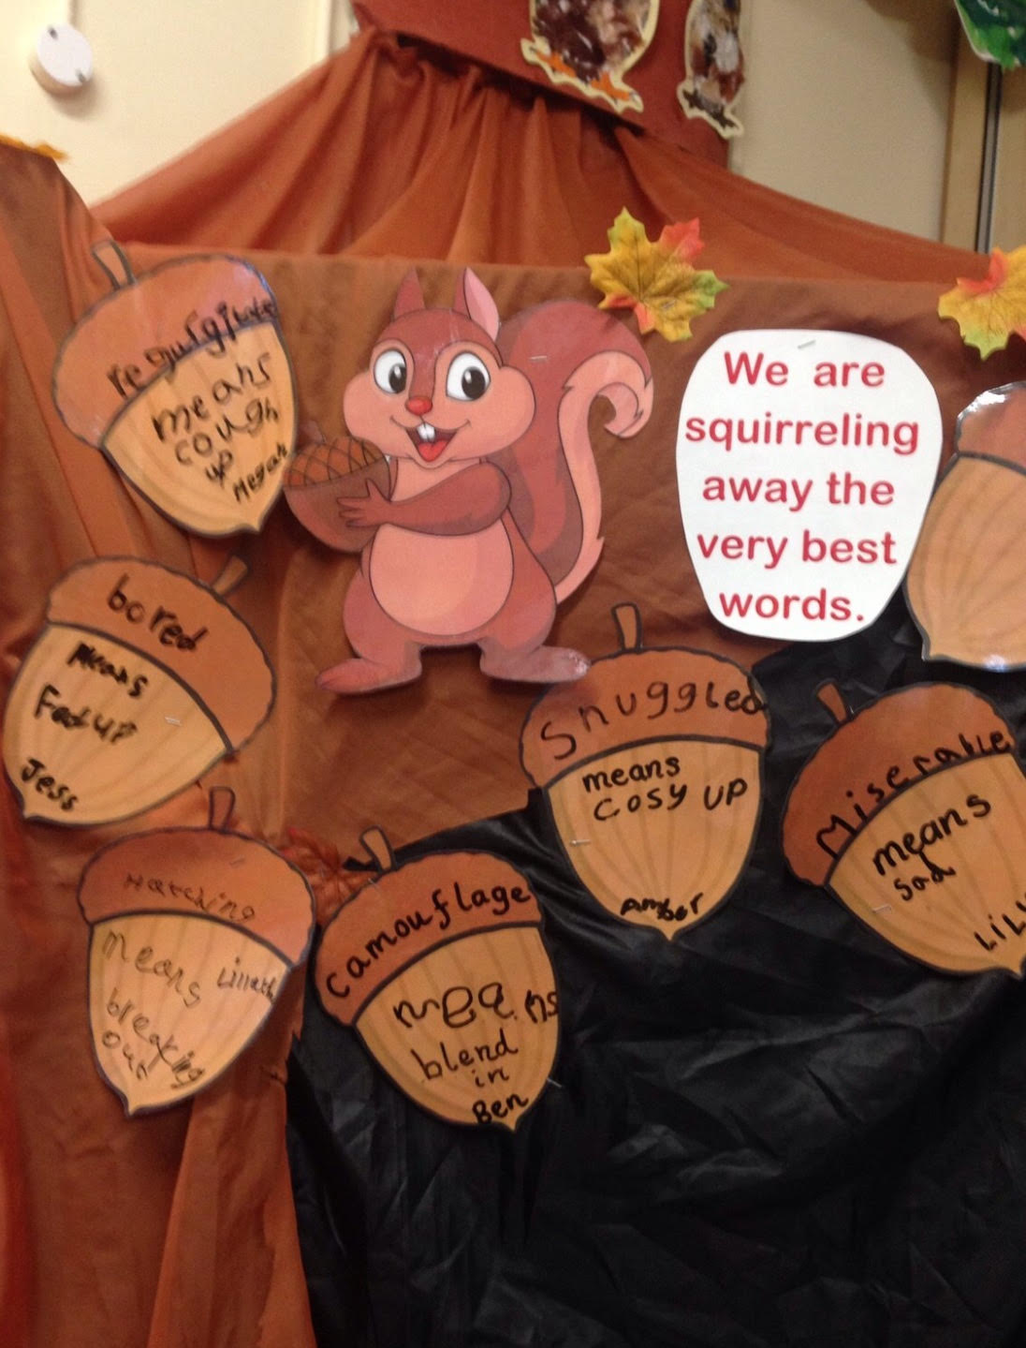
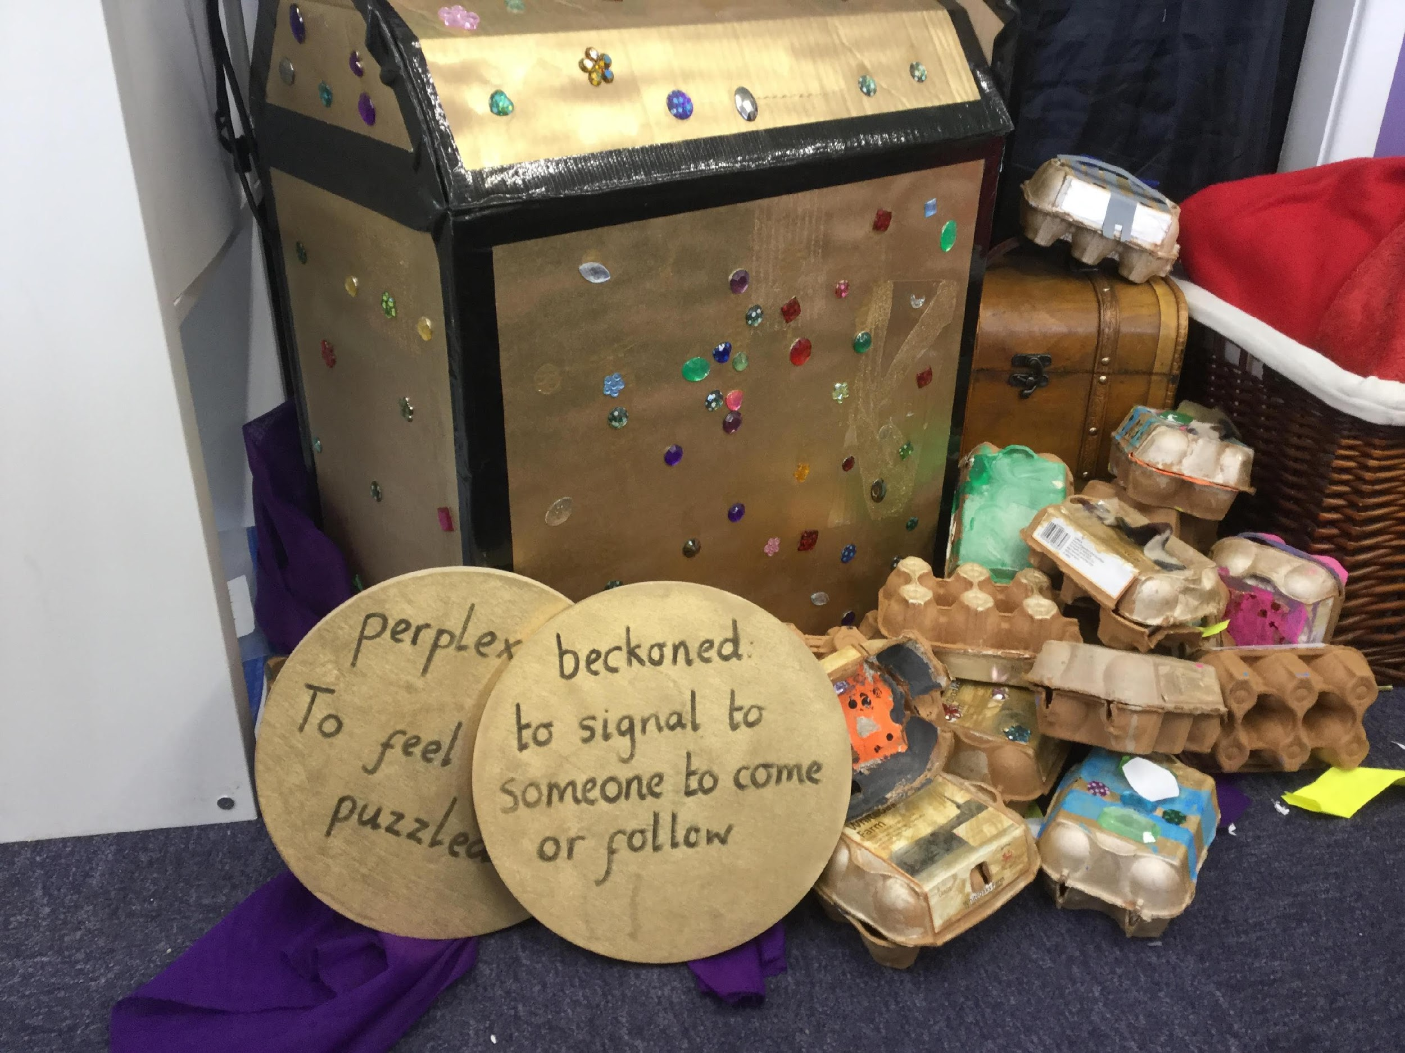
Vocabulary in classrooms…

Slide 18


Slide 19
What we’d like to see at home
An environment that books are a part of
  How often do your children see you read a book or newspaper?
Children being heard read 5 times a week…no matter what age
  This helps develop the mechanics of reading and helps increase fluency, expression and stamina
Children being read to daily – even for a short time!
Library visits
  There are a wealth of books available for free!
Print in the environment
  Talking to children about writing that is in their every day lives is so important
  Labels on toys/clothes/food packaging, signs in shops/roads, etc.

Slide 20
What we’d like to see at home
Technology
  It has its place but should not be used to replace books
  Kindle – memberships
  Audio books/CDs (bedtime, travel)
Reading games and App’s
  Teach your monster to read
  Phonics games
Magazine subscriptions
  Storytime
  Comics
  Snap Science
  First News (A newspaper aimed at Year 4,5 and 6 children.

Slide 21
Finding a nice quiet space…
Reading should be a special time for children and adults to share
Relaxing time – no interruptions!
Comfortable, warm and snuggled up with a book

Slide 22
National Curriculum Expectations
EYFS – Early Learning Goals for Reading
  Children read and understand simple sentences. They use phonic knowledge to decode regular words and read them aloud accurately. They also read some common irregular words. They demonstrate understanding when talking with others about what they have read.
Year 1 – Phonics Assessment
  Assesses the mechanics of reading – decoding, blending and segmenting
Year 2 (End of KS1) – SAT’s Assessment and Teacher Assessment
  Assesses the mechanics of reading (90 words in a minute)
  Assesses comprehension skills
Year 6 (End of KS2) – SAT’s Assessment
  Assesses the comprehension skills

Slide 23
Any Questions?
We will put this powerpoint on the Forest Federation website, alongside:
a.) Pie Corbett’s Reading Spine
b.) Pie Corbett’s Recommended reads
c.) Pie Corbett’s Poetry Spine
In addition, feel free to come and chat to us, if any further questions crop up.

Slide 24
References
1.)Scarborough, H. (2001). Connecting early language and literacy to later reading (dis)abilities: Evidence, theory, and practice. Pp. 97-110 in S. B. Neuman & D. K. Dickinson (Eds.) Handbook of Early Literacy. NY: Guilford Press.
2.) Scholastic Reading Research (Apologies I couldn't find the journal link)
https://www.scholastic.com/readingreport/Scholastic-KidsAndFamilyReadingReport-5thEdition.pdf

