Slide 1

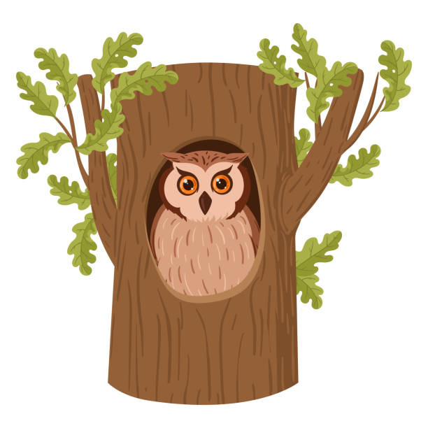
Computing
Years EYFS/1 and 2
Autumn Term 1, 2024
In the dark, dark woods.
PSHE
Children will be improving their mouse skills by learning how to log in and navigate around a computer. Children will be learning how to drag, drop and control their cursor using a mouse. We will learn how to use computers more purposefully and use software tools to create art on the computer.
PE
Children will understand that families and friends can look different. They will also spend time thinking about their friends and what they like doing with them; as well as what their friends look like when they are sad, angry, tired or happy. The children will learn that friendships are not always perfect and will need to work well as part of team. Children will also look at stereotypes and think about why having good manners is important.
. ​
RE
We will be exploring the fundamental skills of balancing, running, changing direction, jumping, hopping and skipping. The children will explore these skills in isolation as well as in combination. They will be given opportunities to identify areas of strength and areas for improvement. Additionally they will work collaboratively with others, taking turns and sharing ideas..
We will encounter stories and text that say something about different people being unique and valuable, making links to Christian and Jewish worldviews and the belief that God loves all people. We will think carefully about ways both Christians and Jews care for people around the world and how this action links to teaching found within the Bible and the Torah.
EYFS: Children will explore numbers to 10, comparing quantities and patterns.
Year 1: Children will explore addition and subtraction within numbers to 10 and up to 20. Looking at number bonds which is a different ways of making 10.
Year 2: Children will explore numbers up to 100, looking at place value, addition and subtraction with numbers to 100 and multiplication and division facts for the 2,5,10 times tables.
We will be looking at the text ‘Owl Babies’ and will be writing our own ‘Wishing Tale’. As we explore this we will work on the following:
EYFS: Retelling a story, using a story mountain, using the determiners the/a and using finger spaces.
Year 1: We will be looking at story mountains and the use of connectives, specifically: and/or/but. We will also be looking at capital letters for names.
Year 2: We will look at exclamation sentences, capital letters and the power of 3.
We will explore the four different seasons, beginning by observing how the weather changes throughout the year. We will also examine how trees transform in each season and identify key events that occur during these times. Additionally, we will recognize how daylight hours vary with each season and record our observations to create a pictogram. Finally, we will gather and analyze data to observe the changes across all four seasons.
We will explore ‘What is my history’. They will be given opportunities to explain their special memories. They will talk about how they celebrate different events in their families such as birthdays, Christmas and Easter. We will explore how childhood has changed over time. We will finish this unit by burying a time capsule in the school playground.
DT.
EYFS: We will explore Junk Modelling. The children will learn the names and use of various craft tools and materials.
KS1: Children will construte a windmill. The children will make stable structures, which will eventually support the turbine, out of card and tape. :
Music
.Children will explore how they can use their voice and bodies to make sounds, experiment with tempo and dynamic when playing instruments.
Maths
English
Science
History
DT/Music

