Slide 1

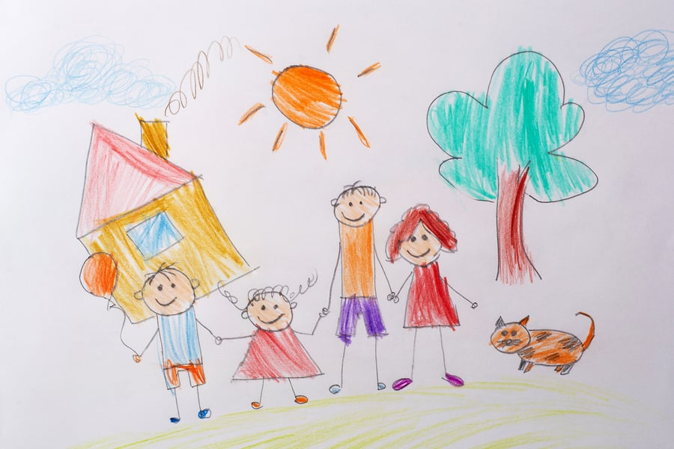
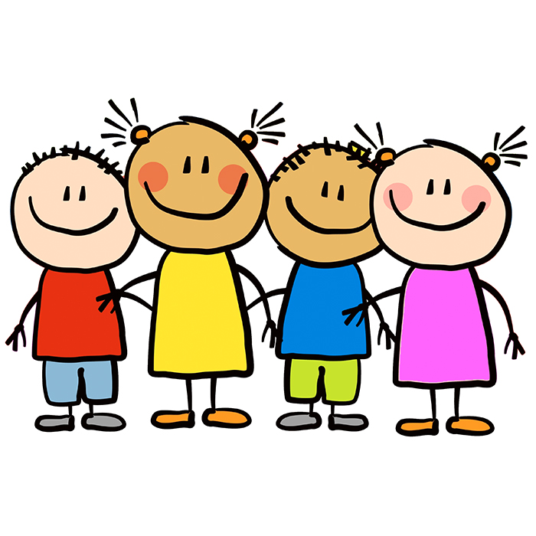
Reception
Autumn Term 1
Communication & Language
This term we will be thinking about the fundamentals of listening, how we show we are listening and following basic instructions. We will be talking in front of our peers and talking to adults in and around the classroom.
This will be explored through our provision and classroom routines and within all lessons.
Personal, Social & Emotional Development
We will be looking closely at our emotions and recognising how these can make us feel. We will be learning that everyone feels emotions and what kind of things we can do when we feel them. We will think about ourselves as individuals and the values we bring., We will be developing our growth mindset as we think about mistakes and how we learn from them.
We will be looking at washing our hands and using the toilet independently as well as doing up our coats.
Physical Development
As we begin the year, we will be identifying our dominant hand when writing. We will be building hand strength by using tweezers and developing a good pencil grip. We will be threading, cutting and writing some letters.
As we think about our gross motor skills, we think about how we move safely in a space, how to navigate a busy playground and basic balancing.
Knowledge & Understanding Of The World
We look at our own past and present, beginning the understandings of history. Through RE learning, we begin to learn about different cultures and beliefs around us. We look at our families and who is in our close and wider families.
We look closely at the seasons and in particular autumn and what our world looks like at this time.
Expressive Arts & Design
Through provision and through lessons, we will learn how to join materials, how to build and explore with construction materials and how to select appropriate tools for a job.
We will be taking part in music and singing games and songs and how we can express our likes and dislikes about a piece.
​Mathematics
We begin the term by matching simple objects and colours to then sorting objects and discussing our reasons for this. We will be counting at first up and down to 10 and looking at how we can recognise and write these numbers.
We will be ordering items by size and sequencing the events that happen in a day.
Literacy
This term, we will be looking at two stories; ‘Dear Zoo’ and ‘Noisy Farm’. We work this term largely on retelling and changing the stories orally with our own ideas. We will be learning key vocabulary and we will be beginning through phonics and in lessons to write some key sounds.

