Slide 1


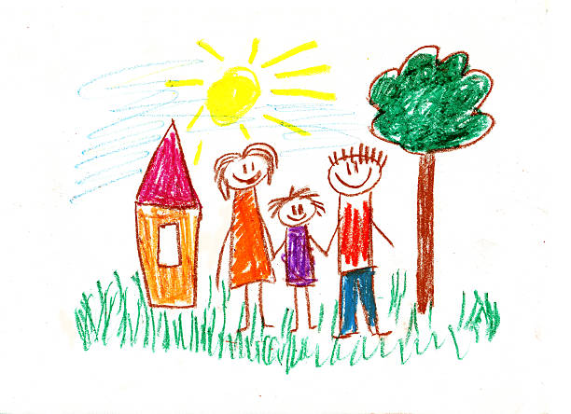
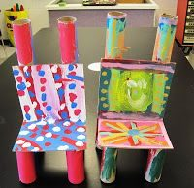
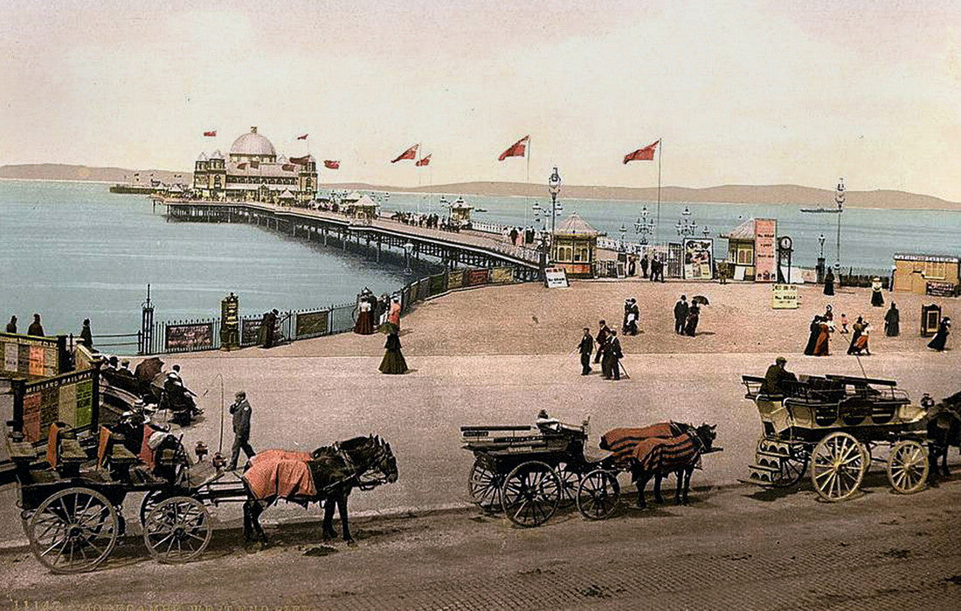
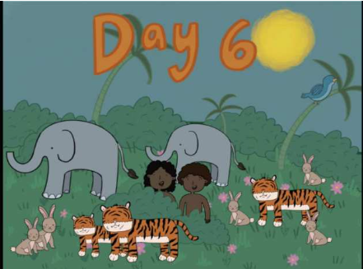
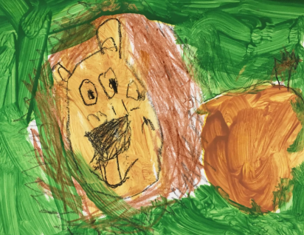
This term we will be thinking about our home life and families. We will be drawing our families and discussing positive relationships and how these draw parallels with friendships. We continue on to look at our emotions and manners.
Our unit this term is ‘’What Is A Computer’’. We will be looking closely at the different parts of a computer and their basic functions. We will be identifying computers in our everyday life and will move on to understanding the meaning of inputs and outputs.
Years 1 and 2
Autumn Term 1 2025
PHSE
Computing
In RE, we begin the year by looking at the Christian story of creation. We retell the Christian story and recognise that it is the first ‘big story’ in the Bible. We move on to think about God giving his creation to humans and views on looking after the planet. We then think about saying thank you to God as we approach harvest.
RE
PE
In PE this term we will be looking at basic skills such as throwing, catching and movement as we prepare to build on these skills throughout the year.
We spend a lot of time in both Year 1 and Year 2 this term looking at place value. We think about the value of tens and ones and the importance of each column.
We look closely at counting and the use of key resources such as number lines, number squares and practical resources that will help us in maths as the year progresses.
We begin the term by looking at ‘Peace At Last’. This is a ‘wishing tale’ and we will be becoming familiar with a wishing tale structure. We will look in depth at sentence structure and capital letters. We will learn about the importance of finger spaces. We will also be looking in depth at nouns, verbs and adjectives. In the second half of this term we will be looking at recounts.
We will be having daily phonics lessons. Please continue reading books and sight words at home.
In History this term we will be thinking about the question, ‘What is history?’
We begin by looking at what our perception of history is and then looking closely at our own history. We move on to look at memories we have and then memories of the past from others, particularly focussing on seaside memories.
We look closely at seaside holidays in the past and develop key historical skills.
DT
In DT this term we will be making a chair for Baby Bear. We will be looking at how we can build a structure for a purpose. We will be exploring different materials and joining techniques.
Music
We will be investigating the basics of music this term, such as pulse, tempo and dynamics. We will also be practising for our Harvest performance.
Maths
English
Science
History
Art/DT/Music
Our Science unit this term is ‘Habitats’ and we will be understanding and describing life processes and how habitats work.
We will be looking closely at a variety of habitats and how animals and plants within them rely on each other for existence and food. We will be working scientifically as we investigate and find out about different animals and their needs.

