Slide 1
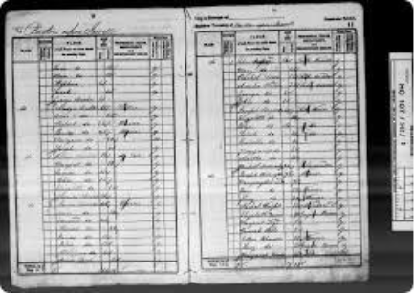

History – What can the census tell us about local areas?
Shakespeare Class
Autumn Term 1 2025
We will be studying the unit 'Families and Relationships' in our PSHE lessons this term.
In addition to teaching skills to support pupils across the curriculum, the unit we will cover is called Bletchley Park and codebreaking.
PHSE
Computing
This term, we study ‘Creation and science: Conflicting or complimentary?' Surrounding this, as always, is our Collective Worship and opportunities to reflect spiritually throughout life at school. Our value this term is ‘Thankfulness.'
In PE, we will be studying hockey. Please ensure kit is in school every day throughout the year as PE days could be subject to last minute change.
RE
PE
In English, we will start the term by completing a fiction unit called ‘Defeat a Monster.’ Our targets include vivid descriptions of character and setting and developing action sequences.
Our class reader for this term is ‘A boy called hope’ by Michael Morpurgo
Both Year Groups will continue to use Maths No Problem as a platform to develop their learning.
In Year 5, we focus on Numbers to 1000 and applying all four operations in addition, subtraction, multiplication and division units.
In Year 6, we focus on Numbers to 10 million, the four operations and fractions.
Our topic this term is ‘Classification – big and small’ which looks at the Linnaeus classification system. This will then lead on to understand how vertebrates, invertebrates and plants are classified.
Our History unit is called ‘What can the census tell us about local areas?’
In Design, the topic we are studying is called, ’Making waistcoats.’
In Music, we are studying ‘looping and remixing.’
In MFL, we will study French transport.
English
Maths
Science
History, Music, Art & DT, MFL

