Slide 1

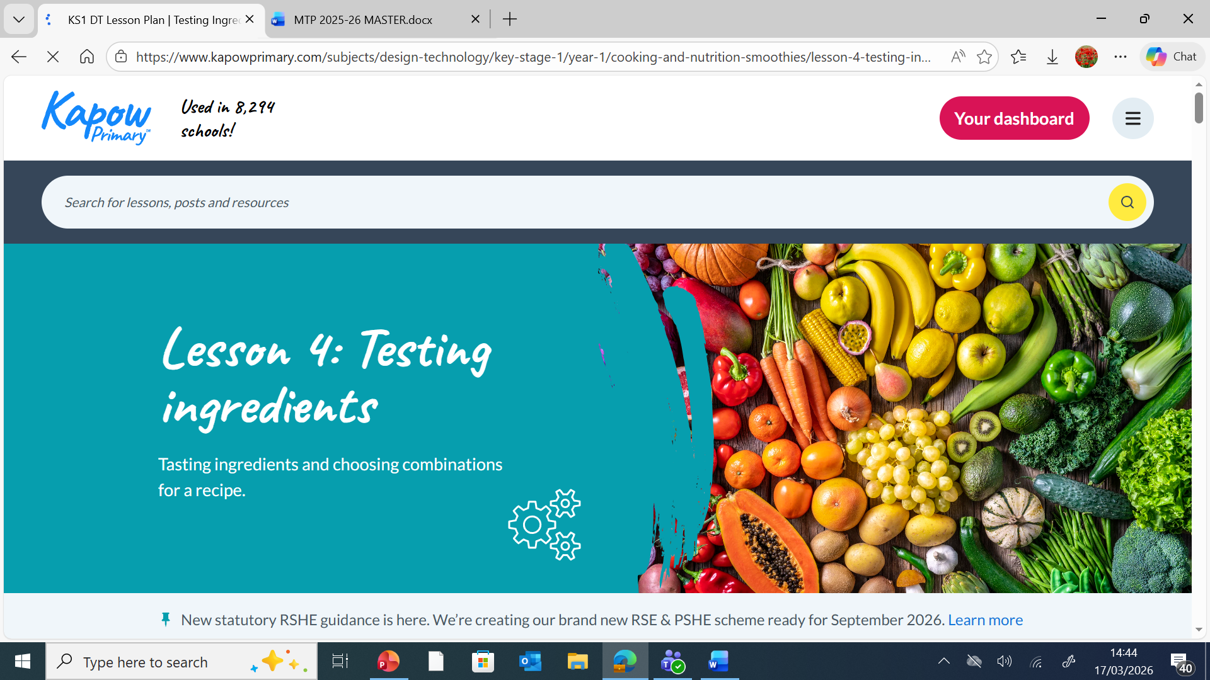
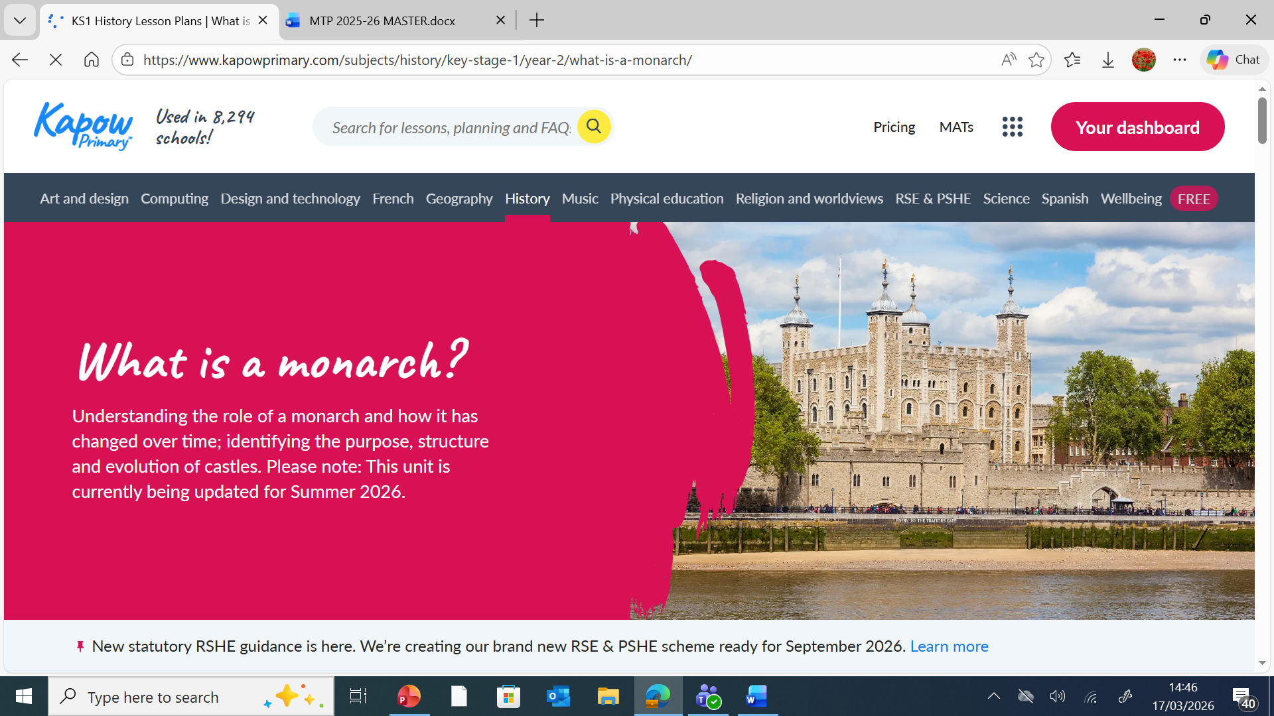
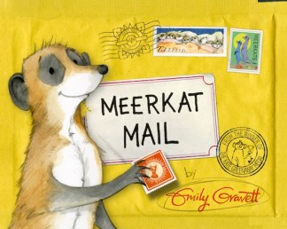
The children will explore creating media : Stop motion using tablets. They will create animations, story boarding , creative ideas and decomposing a story into small parts of action.
Year 1 and 2
Summer Term , 2026
What is a Monarch?
PSHE
Computing
. ​
Safety and the Changing Body
Year 1: They will learn how to keep safe. d understand that some types of physical contact are never acceptable.
Year 2: They will understand what a secret is and what a surprise is. They will learn the names of parts of the body, including those of the private parts for their gender.
Our unit this term is ‘What makes some places sacred to believers? ’The children will find out about various places of worship and why they are important to many believers. They will focus on the key features of churches, mosques and synagogues learning about how these can vary within different traditions. Children will also spend time considering the similarities that all places of worship have and how they support their local communities in practical ways
.
PE
RE
Our PE topic is focused on Striking and fielding game. The children will be put into two, one, the batting team, try to score points and the other, the fielding team, try to stop the batting team from scoring. Examples of striking and fielding games include cricket and rounders.
Year 1
Multiplication: Children will learn about equal groupings, repeated addition, arrays and doubling.
Division : We will explore taking a limited number of items and placing into equal groups to determine how many groups there will be.
Fractions: We will explore making halves and quarters.
Numbers to 100: The children will explore counting in tens and ones.
Year 2
2D Shape: The children will focus on 2D shapes and their different properties. They will identify vertices before learning about lines of symmetry.
3D Shape: The children will recognise, describe and group 3D shapes.
..
This term in English, the children will learn to make their writing more vivid and engaging using Meerkat Mail. They will be adding feeling and extra detail to a character’s actions, helping the reader clearly understand their thoughts, emotions, and reactions. They will also name objects and places precisely, creating a strong and clear picture in the reader’s mind. By using repetition and descriptive language, they will pile up details to make scenes more exciting, lively, and memorable. These activities will help them develop confident descriptive writing skills while enjoying the adventurous world of the meerkats.
Maths
English
This term we will be exploring plants. The children will learn to identify plants and their features. Be able to recall some of the roles that flowering plant parts have and name some trees and their parts. They will learn to identify similarities and differences between deciduous and evergreen leaves. They will learn to recall that seeds and bulbs come from plants and recognise that seeds need water for growth.
The children will recall that a monarch is a king or queen. They will be able to identify some of the monarch’s roles. They will be able to explain that a king or queen is crowned in a special ceremony called a coronation. They will be able to use sources to explain how William the Conqueror became King of England. The children will be able to explain how castles have changed over time and make comparisons between past and present monarchies.
DT
Making Smoothies
Children will be able to describe basic characteristics of fruit and vegetables and prepare fruits and vegetables to make a smoothie.
Music
During this term the children will use their voice to create a variety of sounds. They will collaborate with peers to contribute to a group soundscape and be able to identify changes in dynamics. During the unit they will compare two pieces of music using musical vocabulary to describe the changes in dynamics.
Science
History
DT/Music

